Slide 1
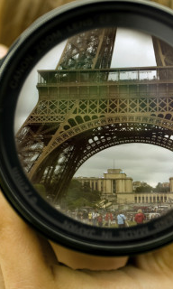
Digital Photography
Mrs. Jennifer Bible
Designed to meet California State Art, Technology, and Common Core Standards.

Slide 2
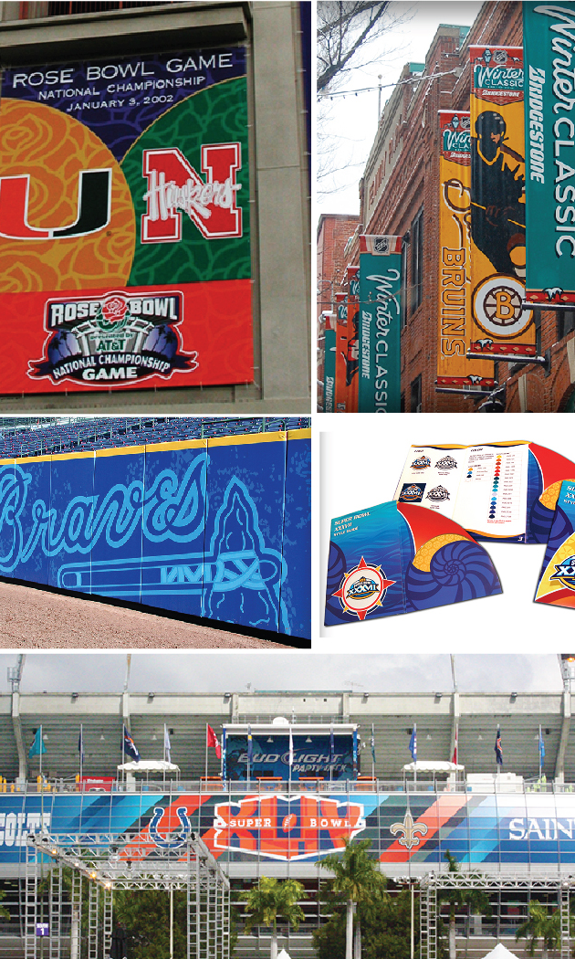
About Me
Teaching for 5 years
(3 @ Cal High).
15+ years experience in Graphic Design &
Art Direction.
Freelance / Contract Graphic Designer.
Amateur Photographer

Slide 3
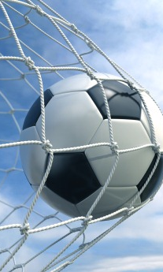
Goals
Teach students to create well constructed photos.
Help students develop a working knowledge of the camera and Adobe Photoshop CS6.
Develop the skill of Creative Problem Solving and promote Creative Thinking.
Promote effective critique.

Slide 4
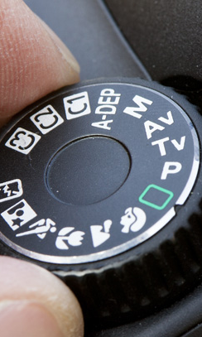
How a Camera Works
We will learn how a camera works, explore different shooting modes, and experiment with lenses and shooting techniques.

Slide 5
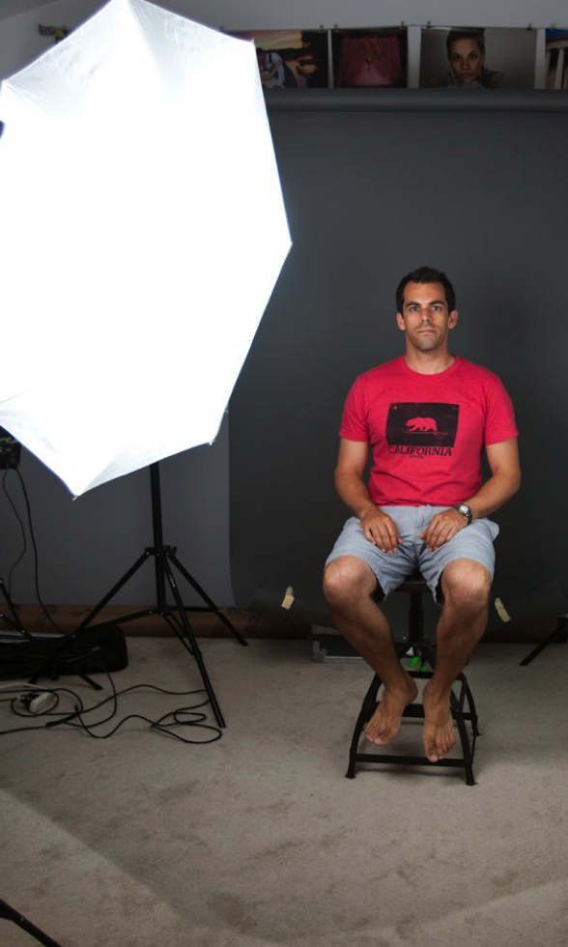
How Lighting Works
Used to create raster artwork, especially good for web and print graphics. Will use to enhance photos and create layered photographic designs.

Slide 6
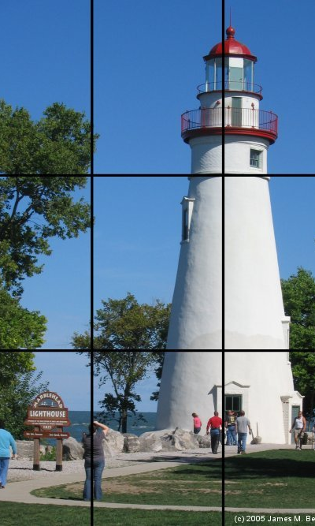
Composition
We will work to achieve strong compositions by looking at the arrangement and relationship of the different parts that make up the whole image.

Slide 7
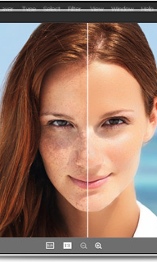
Photo editing software
We will use Adobe Photoshop CS6 and iPhoto to enhance and edit photographs. There will be many tutorials to help with these tricks.

Slide 8
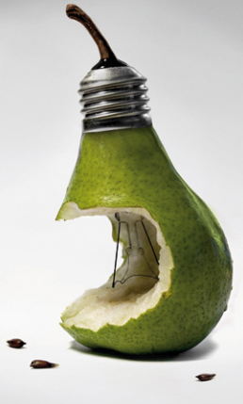
Digital Art
We will use Adobe Photoshop CS6 to take our photography further and create imagery that can not be created by camera alone.

Slide 9
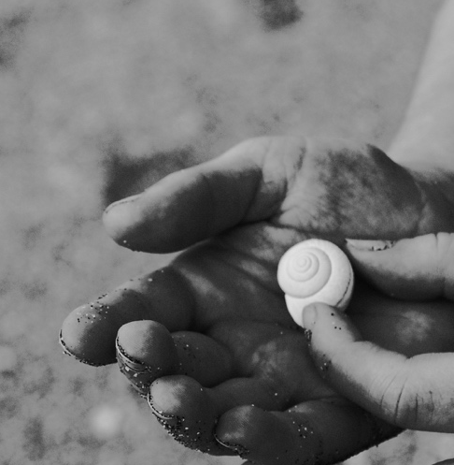
And more…
History of Photography
Careers in Photography
Genres of photography
Presentation & critique skills

